Slide 1
OLIVER TWIST
UNIVERSITY AFFILIATION
DATE

Slide 2
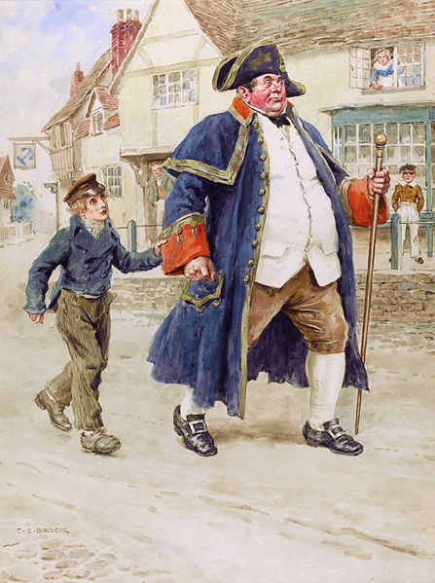
Notes:
The picture is an illustration by Charles Edmund Brock, it shows one of the Oliver twists scene when Mr. Bumbe can be seen trying to sell the young boy who is an orphan into labor illustrating the hardships he underwent.

Slide 3
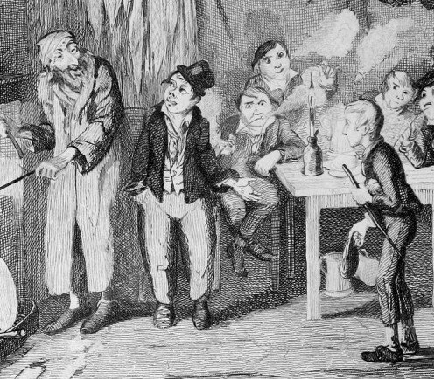
Notes:
Oliver twist’s fate was a usual one, where by the guttersnipes together with orphans fell into bad company. He illustrates the story of an a poor and orphaned young man with the cruelty and life injustices.

Slide 4
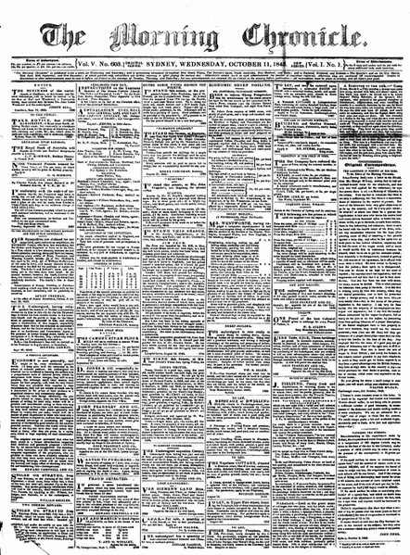
Notes:
The picture illustrates the frontal page of one of the copies of the one of the famous newspapers called The Morning Chronicle, the young Charles used to work for the newspaper as a reporter by giving a voice to those who were poor and vulnerable.

Slide 5
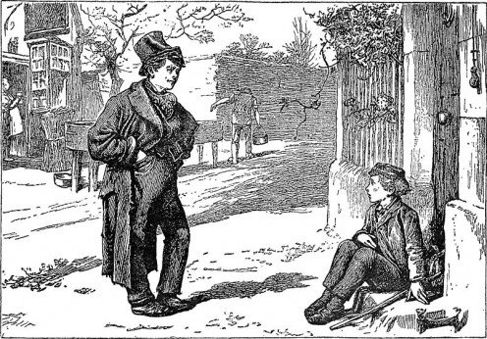
Notes:
Dickens' hero escapes to London and this marks the start of his adventure. Oliver twist meets up with Artful Dodger on one of the London’s streets.

Slide 6
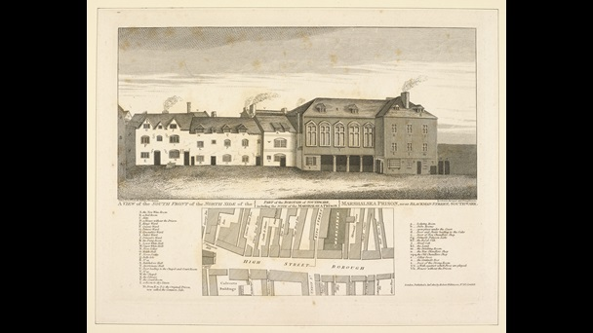
Notes:
The Marshalsea Prison a prison Charles Dickens’ father had to be imprisoned because of debt he accrued with his family, an illustration of injustices done to families who had no financial support.

Slide 7
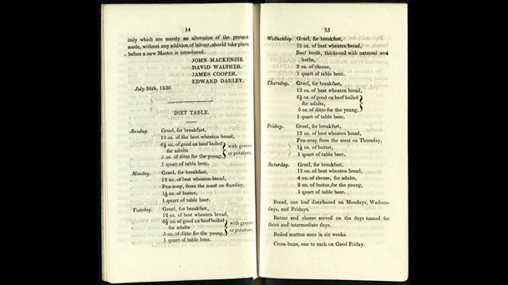
Notes:
The new diet table at the Cleveland street which shows the introduction of what was famously known as a 1834 new poor law. The amendment of the diet was to reduce the amount of sfood provided with the division of inmates by gender.

Slide 8
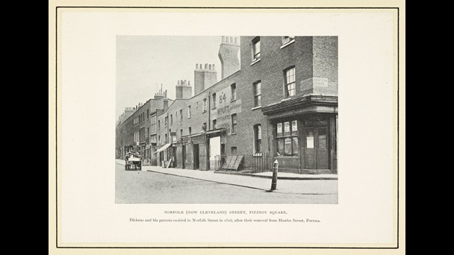
Notes:
Cleveland Street where Dickens stayed during his childhood. It hints at the inability of his father to afford paying of rent resulting into growth of debts. When he wass aged 21 years, he had stayed in more than 17 different addresses.

Slide 9
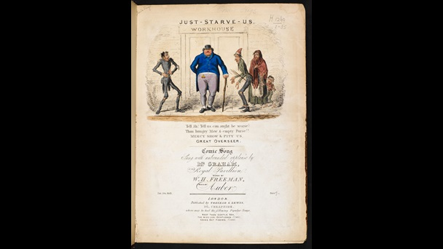
Notes:
An illustration of the workhouse that shows an overseer that is well fed while the inmates look miserable with ragged cloths. It portrays the molestation and misery of the workhouse life.

Slide 10
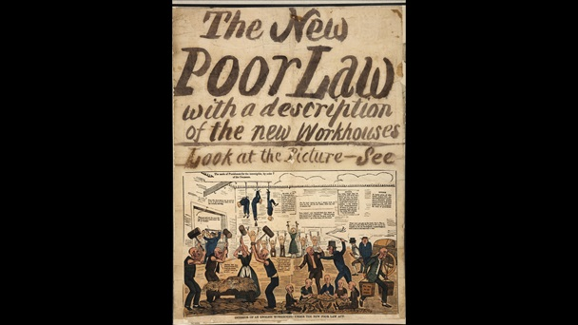
Notes:
The new 1834 Poor Law that was highly criticized. There was poor relief in the workhouse. Families were also divided on the basis of gender, introduction of new forms of injustice to the inmates.

Slide 11
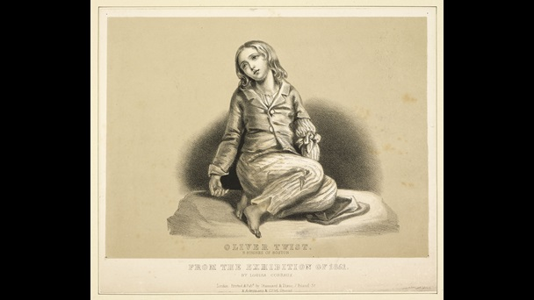
Notes:
Thy picture illustrates harsh life Oliver was able to endure while in the work house. This can be judged by the forlorn expression as well as bare feet.

